Slide 1
POWERSKATE PARENT MEETING
Important highlights
POWERSKATE INFORMATION & REPORT CARDS…..WHERE TO FIND IT
City Subsidy and Non Qualifier Fee
STORM DAYS
Program Specifics
HEALTHY KIDS! ACTIVE KIDS!

Slide 2
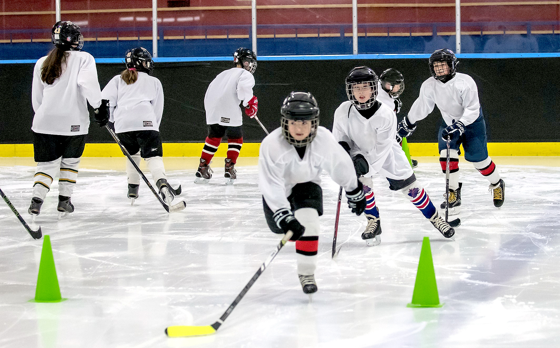

Welcome to POWERskate
Are you new to POWERSKATE? Welcome to SPSC
Team Members
Doreen Pippy is our Club President
Contact us
Jessica Godfrey, Deonna King & Liam Gilks are our Powerskate Coaches
Sandra Burke is our Powerskate Representative (and Club Secretary)
Laurie Godfrey is the Club Administrator
If you are returning… Welcome Back
You can reach any of our board or coaches through our office email office@sherwoodparkdaleskatingclub.com or go to our Contact us page for individual contacts or direct link to our club address

Slide 3



Slide 4
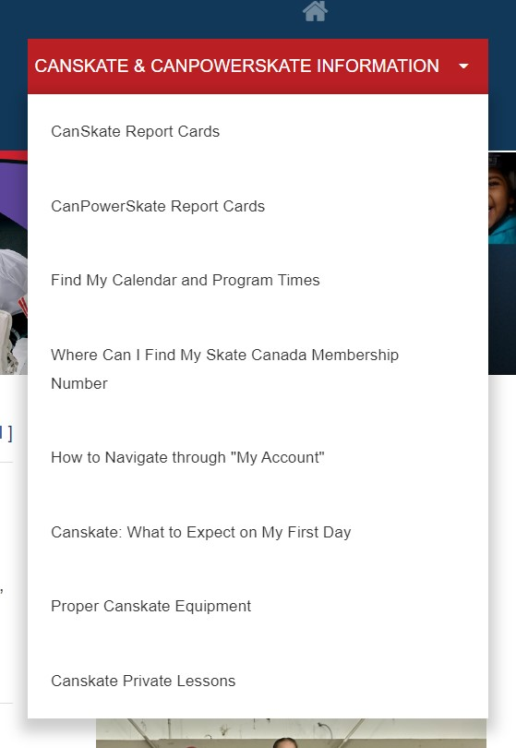
How to find things
Drop down menu
Where to find answers

Slide 5
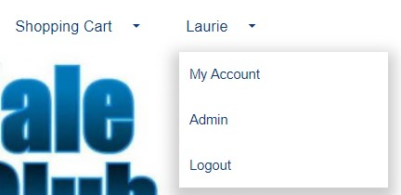
Your Account
Click on the drop down that reads My Account
Once in your account you can access your profiles
  Update contact information
  Review your participants and their evaluations or achievements
  THE CALENDAR tab while logged into your account shows all your registered skating times and events.
  Invoice tab for copies of all your registrations

Slide 6
City Subsidy
The club will need to confirm addresses of those that qualify for the city subsidy.
The subsidy covers the balance of the full program cost
Paying a subsidy non-qualifier fee
  This amount is the same amount as what the city pays for those within their city limits
  Where to address concerns

Slide 7

STORM WATCHES AND CLOSURES – in the event of storms or unforeseen closures, we will post on our website as well as send you an email. We normally only close if the facility is closed. Therefor if you see from a community posting that the arena is closed, then so are we. There is the off-chance if our administrator does not have power, they will not be able to email you. Please don’t call the arena as they are not part of our operation for detailed info.
Please keep your account contact info up to date. You can add a second email to your account if needed

Slide 8
PROGRAM Specifics
SPSC runs the updated approved Skate Canada Powerskate Program.
There are varied levels of skaters on the session
  Early Stage of Development
  Moderate Stage of Development
  Advanced Stage of Development
Skaters will work in a group format on varied skills with different targeted expectations to achieve the quality required at their stage of development.
Dryland off-ice session included in your registration is to further enhance the development of the athlete

Slide 9
Coaching Staff
There will be up to three professional NCCP certified coaches on the ice.
Assisting them are our Program Assistants.
  Program Assistants are experienced skaters from a hockey and/or ringette background

Slide 10
Healthy Kids! Active Kids! Fundraiser
Our Main Club Fundraiser
This is not mandatory however we are asking all Canskaters and Powerskaters to consider purchasing at least one item.
With continual rising costs we are doing everything we can not to raise registration fees and would rather you purchase food for your tables which can in turn raise funds to keep fees down for the club.
Returning partner “Mike’s Queen Street Meat Market”
If you are keen and you purchase more than 10 items, you will receive a credit on your personal account as well as helping the club overall.
Extra order forms are available. We will also email out a copy for printing or using digitally.

Slide 11
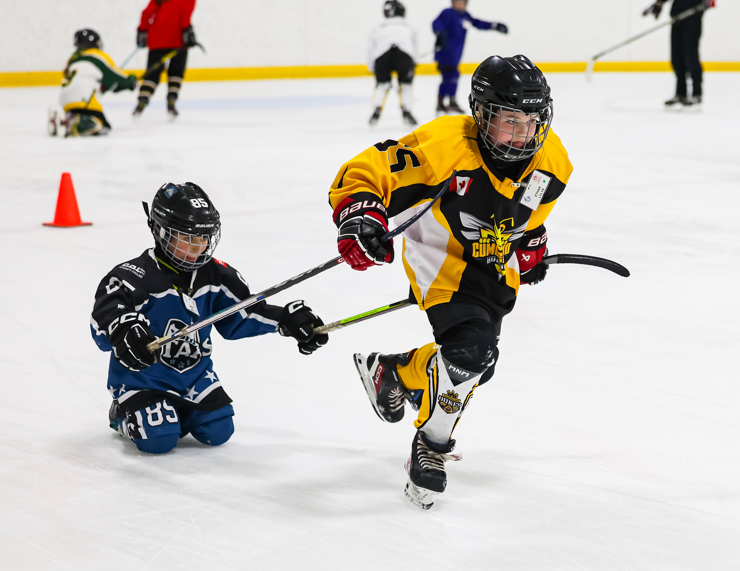

We are always looking for volunteers
This can be during your scheduled skating time only
Special events
Join us on the board of directors as a member-at-large or specific role
Help us build your program in your club!

Slide 12
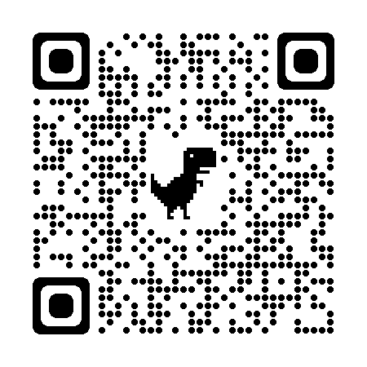
Club Apparel
We have a store available through Allstar Cresting
  There are t-shirts, hoodies, outdoor jackets and more – Get in the spirit with quality merchandise. 10% goes to the club.
Here at the club, we also have mittens/gloves and a limited supply of skate guards for sale

Slide 13

Thank you

